Slide 1

A Project Review Meeting on A Multi-Dimensional Music Discovery Platform Incorporating Personality, Location, Temporal Context, and Immersive Visualization
By
SHANTAN - 2420030620
U. RAHUL - 2420080025
SRIRAM - 2420030676
Team Number: 1
Under the guidance of
Dr. Y. Subbarayudu
Assistant Professor
Department of Computer Science and Engineering
Koneru Lakshmaiah Education Foundation (Deemed to be University estd. u/s. 3 of the UGC Act, 1956) Off-Campus: Bachupally-Gandimaisamma Road, Bowrampet, Hyderabad, Telangana - 500 043. Phone No: 7815926816, www.klh.edu.in

Slide 2
Outline of the Presentation
Abstract
Introduction
Problem Statement
Project Flow Diagram
Objectives with Justification
Modules[Frontend web pages]
Expected Outcomes of the Proposed Work
Conclusion
References

Slide 3
Abstract
This project presents the design and development of a Reflective Gradient Music Player Web Application that integrates aesthetic design with smart recommendation features. The system is built using HTML, CSS, and JavaScript, providing users with a visually immersive experience enhanced by reflective animated gradients. Along with basic functionalities like song playback, playlists, and favorites, the application introduces a “Vibe Mixer” recommendation engine that generates personalized playlists based on user mood, energy, tempo, and contextual preferences such as time of day and location. By combining UI innovation and context-aware recommendations, this project demonstrates how modern web technologies can deliver a rich and engaging music streaming experience.

Slide 4
Introduction
Music streaming has become an integral part of digital entertainment. While existing platforms focus heavily on song libraries, they often lack customizable mood-based recommendation features and immersive user interfaces. This project addresses both aspects by developing a web-based music player that combines:
Aesthetic design with reflective, gradient-based backgrounds.
Interactive features like dynamic playlists, favorites, and artist-specific views.
Smart recommendation logic that adapts to user context.
The system demonstrates how front-end technologies can be used to create a personalized experience for music enthusiasts.

Slide 5
Problem Statement
Most music players and streaming platforms provide recommendations based on algorithms but lack transparent control for the user to fine-tune mood, energy, and style preferences. Additionally, the design of many applications is either static or minimalistic, failing to provide an engaging visual environment.
The key challenges identified are:
Lack of user-driven customization in recommendations.
Limited integration of contextual factors (time of day, location, mood).
Minimal emphasis on aesthetic and interactive UI design.

Slide 6
Project Flow Diagram
Flow of the system:
User Login/Access → User lands on the homepage with trending, fresh finds, and playlist carousels.
Navigation → User can explore artists, playlists, or open the Smart Recommendation (Vibe Mixer).
Vibe Mixer → User selects a core vibe (e.g., Focus, Chill, Party), fine-tunes sliders (energy, tempo, mood, style), and adds context (time/ingredient).
Recommendation Engine → System compares preferences with stored song metrics and generates a personalized playlist.
Music Player → Songs can be played with expanded/collapsed controls, favorites added, and progress tracked.
Output → Personalized playlist delivered dynamically with interactive UI.

Slide 7
Objectives with Justification
Design a visually immersive music player – justified by the need for modern UIs that improve user engagement.
Implement smart recommendations – justified by user demand for personalized music discovery.
Incorporate contextual awareness (time, location, mood) – justified to enhance real-world relevance of music choices.
Provide user-driven customization – justified by the lack of control in existing auto-recommendation systems.
Ensure responsiveness and interactivity – justified to make the application adaptable across devices.

Slide 8
Modules [Frontend web pages]
Sidebar Navigation Module – Provides quick access to Home, My Songs, Playlists, and Smart Recs.
Home Page Module – Displays trending, fresh finds, artists, and playlists in carousel format.
Playlist Module – Predefined (Chill Vibes, Workout Mix) and user-created (My Songs).
Artist Module – Shows artist profile with bio and related songs.
Smart Recommendations (Vibe Mixer) – Lets users fine-tune preferences to craft personalized playlists.
Player Module – Collapsed and expanded views, shuffle/repeat, favorites, and progress tracking.

Slide 9
Expected Outcomes of the Proposed Work
A fully functional, interactive music player with immersive reflective gradients.
Custom playlist generation through user-controlled recommendations.
Enhanced user engagement through UI aesthetics and interactivity.
Context-aware music suggestions considering mood, time of day, and location hints.
A scalable front-end project demonstrating how personalization can be achieved in music streaming.

Slide 10
Conclusion and Future Scope
This project successfully combines design innovation with intelligent recommendations, creating a music player that is both functional and engaging. The reflective background, smart playlist generation, and modular structure highlight the potential of web technologies in delivering immersive digital experiences.

Slide 11
References
The Vibe Mixer ✨ – Smart Music Recommendation Engine
Overview:
The Vibe Mixer is an intelligent recommendation feature that allows users to craft personalized playlists by selecting moods, adjusting music attributes, and adding contextual hints. Unlike static playlists, it gives the user direct control over how their listening experience should feel.
How It Works:
Step 1: Choose a Core Vibe
Users select a starting vibe such as Deep Focus, Ambient Chill, Energetic Party, Night Drive, Melancholy Mood, or Joyful Day.
Each vibe loads preset values for energy, tempo, mood, and style.
Step 2: Fine-Tune the Mix
Interactive sliders let users customize:
Energy → Mellow ↔ Intense
Tempo → Slow ↔ Fast
Mood → Sad ↔ Happy
Style → Acoustic ↔ Electronic

Slide 12
Step 3: Add Context
Users can add contextual filters:
Time of day (Morning, Afternoon, Evening, Night).
Special ingredients like Nostalgia, Wanderlust, or Romance.
Location awareness (e.g., Hyderabad → Monsoon Mood).
Smart Recommendation Engine
Matches sliders + context with song metadata (energy, tempo, mood, style, tags).
Ranks songs by similarity and crafts a personalized playlist instantly.
Key Advantages:
🎛️ User-Controlled Personalization – Unlike auto-recommendations, users can actively fine-tune their music preferences.
🌍 Context Awareness – Time, mood, and location influence the recommendations.
🎶 Dynamic Playlist Generation – Each crafted vibe produces a unique playlist.
✨ Immersive UI – Smooth sliders, gradient effects, and reflective design enhance the experience.

Slide 13
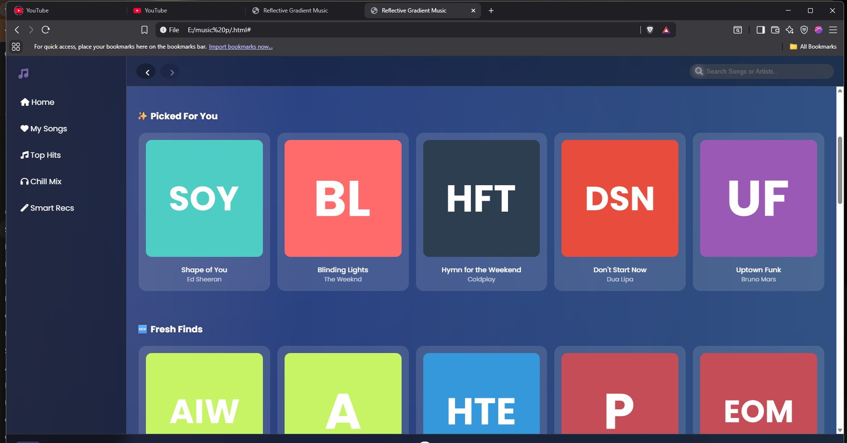

Slide 14
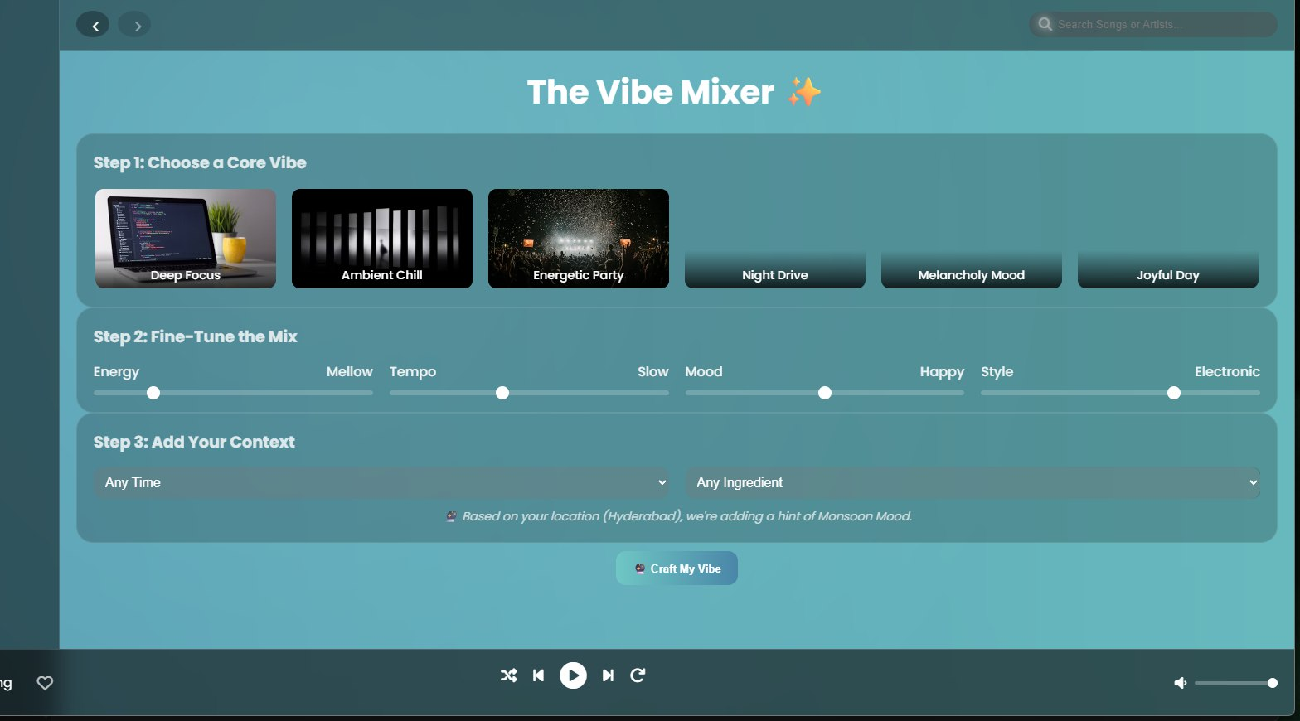

Slide 15
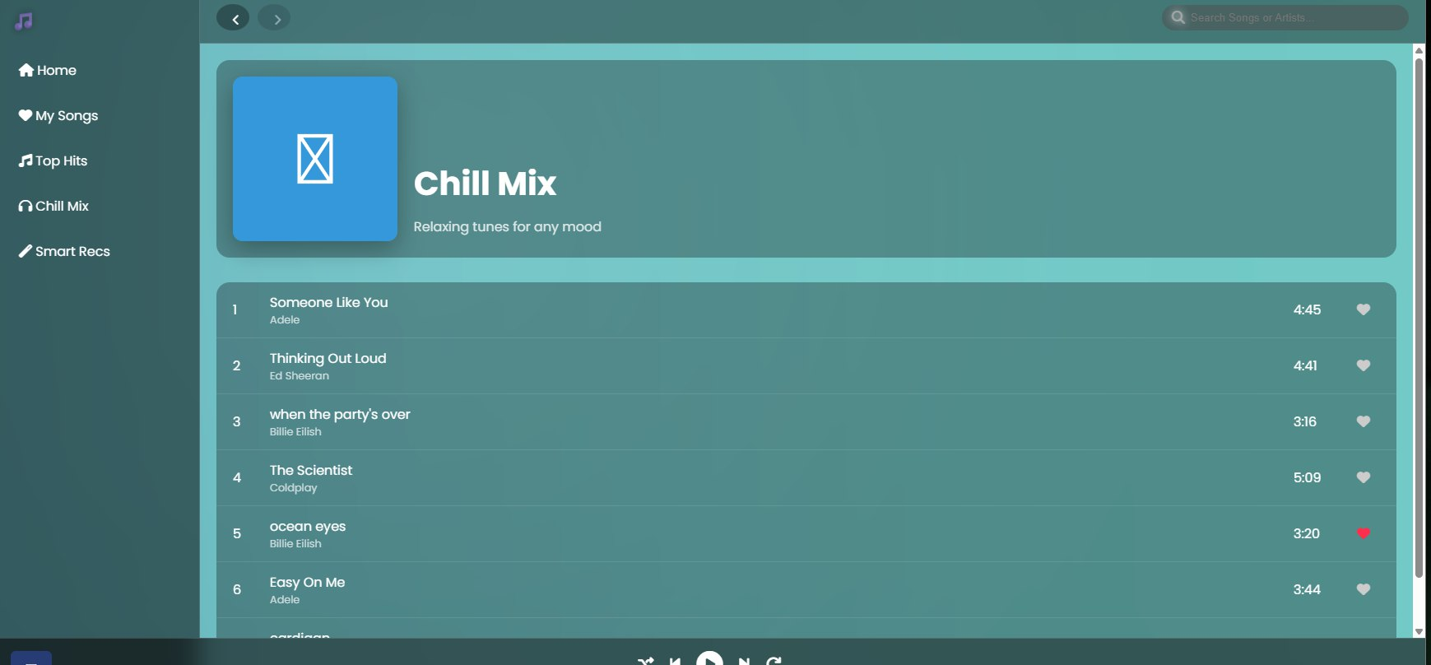

Slide 16
Thank you

